Slide 1
2018-19 MFMA Tabling document
Dr Nkosazana Dlamini-Zuma Municipality
23 January 2020
Presented by Jabulani Nkosi

Slide 2
Dr Nkosazana Dlamini-Zuma Municipality - TABLING briefing note
MFMA 2018-19
CONTENTS Page
GREETING 3
INTRODUCTION 4
AREAS OF ANNUAL AUDIT 5
TYPES OF AUDIT OPINIONS 6
5. OVERALL AUDIT OUTCOME 7
RISK AREAS 10
KEY CONTROLS 11
ROOT CAUSES TO BE ADDRESSED 12
AUDIT OUTCOMES 2018/19 13
OTHER MATTERS OF INTEREST 19
CONCLUSION 23

Slide 3
Dr Nkosazana Dlamini-Zuma Municipality –
TABLING briefing note
MFMA 2018-19
1. GREETINGS
The Honourable Speaker, Honourable Mayor, Deputy Mayor, Councillors, Amakhosi, Chairpersons of MPAC and Audit Committee, Municipal Manager, Administrator, Officials and other guests,
I bring greetings from the Business Executive in KwaZulu-Natal Ms. Ntombifuthi Mhlongo, and greetings from the Auditor-General of South Africa Mr. Kimi Makwetu,
Thank you for the invitation and giving us the opportunity to address council on the audit outcome for Dr Nkosazana Dlamini-Zuma Municipality for the 2018-19 financial year.

Slide 4
Dr Nkosazana Dlamini-Zuma Municipality –
TABLING briefing note
MFMA 2018-19
2. INTRODUCTION
Reputation promise of the Auditor-General of South Africa
The Auditor-General of South Africa has a constitutional mandate and, as the supreme audit institution of South Africa, exists to strengthen our country’s democracy by enabling oversight, accountability and governance in the public sector through auditing, thereby building public confidence.
Purpose
Our role as the AGSA is to reflect on the audit outcomes and root causes to assist the municipal council in its oversight role to assess the performance of the municipality.

Slide 5
Dr Nkosazana Dlamini-Zuma Municipality - TABLING briefing note
MFMA 2018-19

Slide 6
Dr Nkosazana Dlamini-Zuma Municipality - TABLING briefing note
MFMA 2018-19

Slide 7
Dr Nkosazana Dlamini-Zuma Municipality - TABLING briefing note
MFMA 2018-19
5. OVERALL KEY MESSAGE
Trends in audit outcomes Types of audit outcomes
2
2
Unqualified with findings
Unqualified with findings
Unqualified with findings
Unqualified with no findings
…
Unqualified with findings
Qualified with findings
Adverse with findings
Disclaimed with findings
2018-19
2017-18
2016-17

Slide 8
Dr Nkosazana Dlamini-Zuma Municipality –
TABLING briefing note
MFMA 2018-19
Annual financial statements | Movement | 2018/19 | 2017/18 | 2016/17
Audit opinion |  | Unqualified | Unqualified | Unqualified
Audit of Predetermined Objectives (AoPO) | Movement | 2018/19 | 2017/18 | 2016/17
Basic service delivery and infrastructure development (Material findings) |  | One | One | One

Slide 9
Dr Nkosazana Dlamini-Zuma Municipality-
TABLING briefing note
MFMA 2018-19
Compliance with legislations | Movement | 2018/19 | 2017/18 | 2016/17
Annual financial statements (material findings) |  | One | One | One
Procurement and contract management (material findings) |  | One | Two | Two
Strategic planning and performance management (material findings) |  | None | One | Two
Expenditure management (material findings) |  | One | None | None
Consequence management (material findings) |  | Two | None | None
Asset management (material findings) |  | None | One | None

Slide 10
Dr Nkosazana Dlamini-Zuma Municipality –
TABLING briefing note
MFMA 2018-19
6. RISK AREAS
Supply chain
management
Quality of submitted financial statements
Quality of submitted performance information
2
…
Financial health
Human resource management
Information technology

Slide 11
Dr Nkosazana Dlamini-Zuma Municipality - TABLING briefing note
MFMA 2018-19
7. KEY CONTROLS
Status of drivers of internal control
Financial and performance management
2
2
Leadership
Governance
Effective leadership culture
Proper record keeping
…
Risk management
Oversight responsibility
Processing and reconciling controls
Internal audit
HR management
Regular reporting
Audit committee
Policies and procedures
Compliance reporting
Audit action plans
IT system controls
IT governance

Slide 12
Dr Nkosazana Dlamini-Zuma Municipality –
TABLING briefing note
MFMA 2018-19
8. ROOT CAUSES TO BE ADDRESSED
The accounting officer should implement consequence management procedures for poor performance and transgressions
Management should perform proper reviews of quarterly, mid-year, and annual performance reports to ensure reported achievements are supported by relevant reliable information.
Management should regularly review and monitor compliance with laws and regulations particularly in the supply chain management.
2
2
…

Slide 13
n/n
Dr Nkosazana Dlamini-Zuma Municipality - TABLING briefing note
MFMA 2018-19
9. AUDIT OUTCOME 2018/19
9.1 Opinion
In my opinion, the financial statements present fairly, in all material respects, the financial position of the Dr Nkosazana Dlamini-Zuma Municipality as at 30 June 2019, and its financial performance and cash flows for the year then ended in accordance with the South African Standards of Generally Recognised Accounting Practice (SA Standards of GRAP) and the requirements of the Municipal Finance Management Act of South Africa, 2003 (Act No. 56 of 2003) (MFMA) and the Division of Revenue Act of South Africa, 2018 (Act No. 1 of 2018) (DoRA).

Slide 14
Dr Nkosazana Dlamini-Zuma Municipality –
TABLING briefing note
MFMA 2018-19
9.2 Emphasis of matter
9.2.1 Material impairments – receivables
As disclosed in note 3 to the financial statements, material impairments of R29,10 million (2017-2018: R25,93 million) were incurred as a result of an annual review of the recoverability of receivables.
9.2.2 Material underspending of budget
As disclosed in the statement of comparison of budget and actual amounts, the municipality materially underspent by R15,73 million on operational costs and R2,93 million on electrification projects.

Slide 15
Dr Nkosazana Dlamini-Zuma Municipality –
TABLING briefing note
MFMA 2018-19
9.3 Predetermined Objectives
The basic service delivery and infrastructure development development priority was evaluated for usefulness and reliability of the reported performance information and the following audit findings were noted:
Objective | Audit Findings
9.3.1 Basic Service Delivery and Infrastructure Development | Three (3) indicators and related targets did not relate to the realisation of the strategic objective of the municipality. This is because the achievement of the indicators was measured through the activities of the projects, instead of the actual number of municipal libraries upgraded, libraries maintained and taxi ranks constructed.

Slide 16
Dr Nkosazana Dlamini-Zuma Municipality –
TABLING briefing note
MFMA 2018-19
9.4 Compliance with legislation
Subject matter | Finding
9.4.1 Annual financial statements | The financial statements submitted for auditing were not prepared in all material respects in accordance with the requirements of section 122(1) of the MFMA. Material misstatements of non-current assets, current assets, revenue, expenditure and disclosure items identified by the auditors in the submitted financial statements were subsequently corrected, resulting in the financial statements receiving an unqualified audit.
9.4.2 Expenditure management | Reasonable steps were not taken to prevent irregular expenditure amounting to R9,3 million as disclosed in note 32 to the annual financial statements, in contravention of section 62(1)(d) of the MFMA. The majority of the irregular expenditure was caused by non-compliance with supply chain management (SCM) regulations.

Slide 17
Dr Nkosazana Dlamini-Zuma Municipality –
TABLING briefing note
MFMA 2018-19
9.4 Compliance with legislation (continued…)
Subject matter | Finding
9.4.3 Procurement and contract management | Some of the commodities designated for local content and production, were procured from suppliers who did not meet the prescribed minimum threshold for local production and content, as required by preferential procurement regulation 8(5). Similar non-compliance was reported in the prior year.
9.4.4 Consequence management | The unauthorised expenditure incurred by the municipality was not investigated to determine whether any person was liable for the expenditure, as required by section 32(2)(a) of the MFMA. Irregular, fruitless and wasteful expenditure incurred by the municipality was not investigated to determine whether any person was liable for the expenditure, as required by section 32(2)(b) of the MFMA.

Slide 18
Dr Nkosazana Dlamini-Zuma Municipality –
TABLING briefing note
MFMA 2018-19
9.5 Internal control deficiencies
The following were the root causes that gave raise to the reported findings in the audit report:
Leadership did not perform effective oversight and monitoring to ensure that delegated officials consistently applied policies and procedures and related internal controls to achieve reliable and credible financial and performance reporting as well as compliance with applicable legislation.
Senior management did not implement adequate review procedures to ensure that the annual financial statements and annual performance report were accurately prepared and supported by reliable and credible information.
The internal audit unit did not perform adequate reviews of the financial statements and annual performance report prior to submission for auditing and also did not review compliance with key legislation applicable to the municipality.

Slide 19
Dr Nkosazana Dlamini-Zuma Municipality –
TABLING briefing note
MFMA 2018-19
10. Other matters of interest
10.1 Irregular expenditure
Definition: Expenditure that was incurred in contravention of applicable laws and
legislations
2018-19 | 2017-18
R9,3 million | R10,9 million

Slide 20
Dr Nkosazana Dlamini-Zuma Municipality –
TABLING briefing note
MFMA 2018-19
10. Other matters of interest

Slide 21
Dr Nkosazana Dlamini-Zuma Municipality –
TABLING briefing note
MFMA 2018-19
10. Other matters of interest (continued…)
10. 2 Fruitless and wasteful expenditure
Definition: Expenditure that should not have been incurred (incurred in vain that could have been avoided and no value for money received)
2018-19 | 2017-18
R328 804 | R 11 690

Slide 22
Dr Nkosazana Dlamini-Zuma Municipality –
TABLING briefing note
MFMA 2018-19
10. Other matters of interest (continued…)
10.3 Unauthorized expenditure
Definition : Expenditure incurred in excess of the approved budget vote
2018-19 | 2017-18
nil | nil

Slide 23
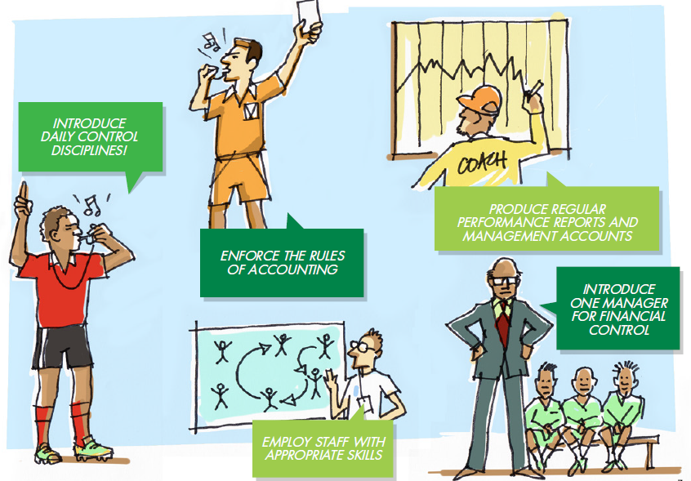
Dr Nkosazana Dlamini-Zuma Municipality –
TABLING briefing note
MFMA 2018-19
11. Conclusion (How to improve audit outcomes)

Slide 24
Dr Nkosazana Dlamini-Zuma Municipality –
TABLING briefing note
MFMA 2018-19
11. Conclusion (How to improve audit outcomes)

Slide 25
Dr Nkosazana Dlamini-Zuma Municipality –
TABLING briefing note
MFMA 2018-19
11. Conclusion
How to improve audit outcomes
Clean administration vs clean audit opinion
Institutionalisation of internal controls
Good governance (capacitation and effectiveness of audit committee, internal audit, functioning oversight structures e.g. MPAC)
Financial and administration systems that are strong and reliable
Reqular, accurate and complete financial performance reporting

Slide 26
Stay in touch with the AGSA

